Slide 1

DONUT WORRY
Good Morning!
248 E Crogan St Lawrenceville, GA 30046
Notes:
Speaker: Connor
Good morning everyone! For our project, we worked with Donut Worry, a donut and coffee shop in Lawrenceville Georgia. We created an online website for them to be able to reach new markets & allow customers to order online. We’ll get in to more information in the following slides, but now let’s go meet the team!

Slide 2
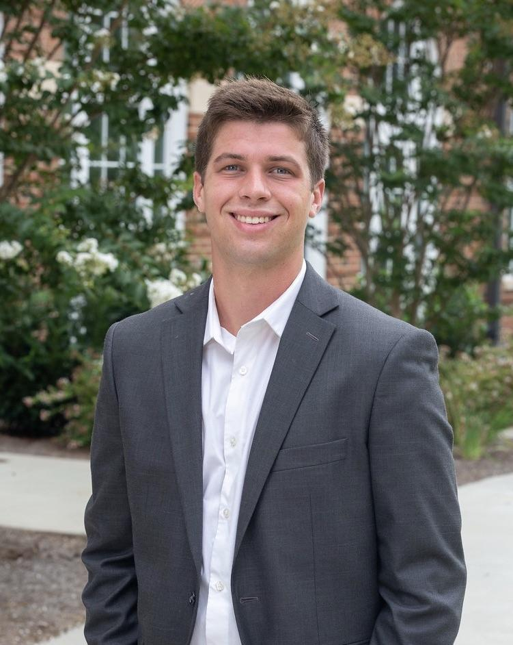
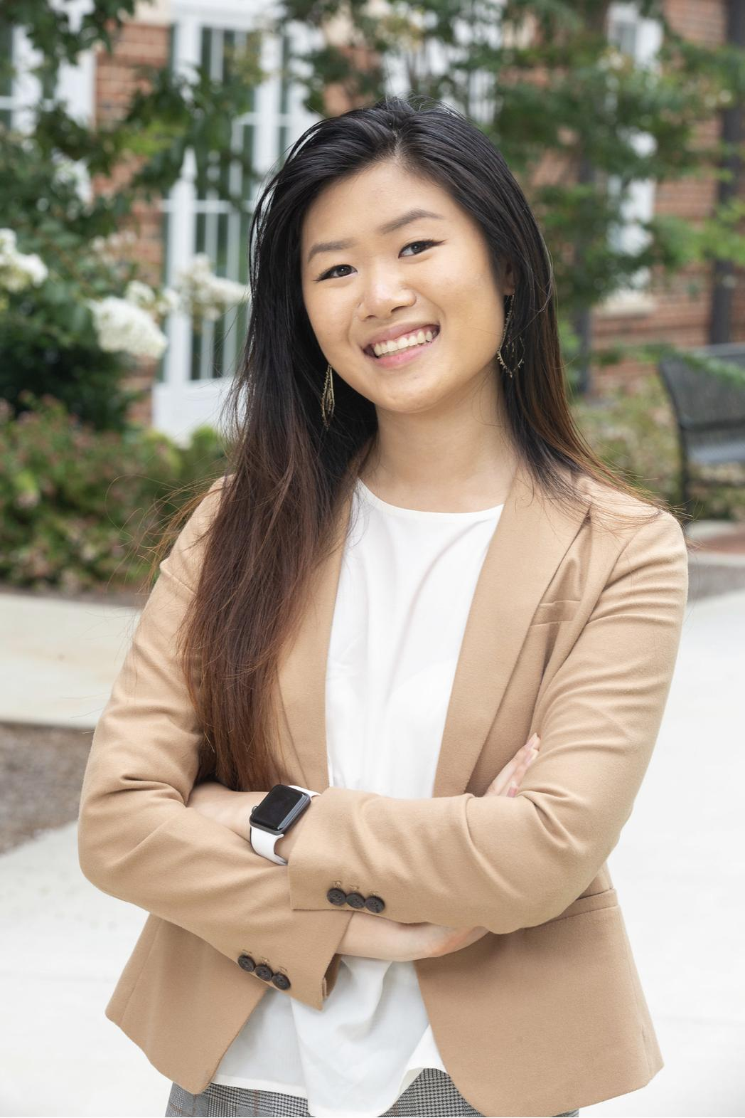
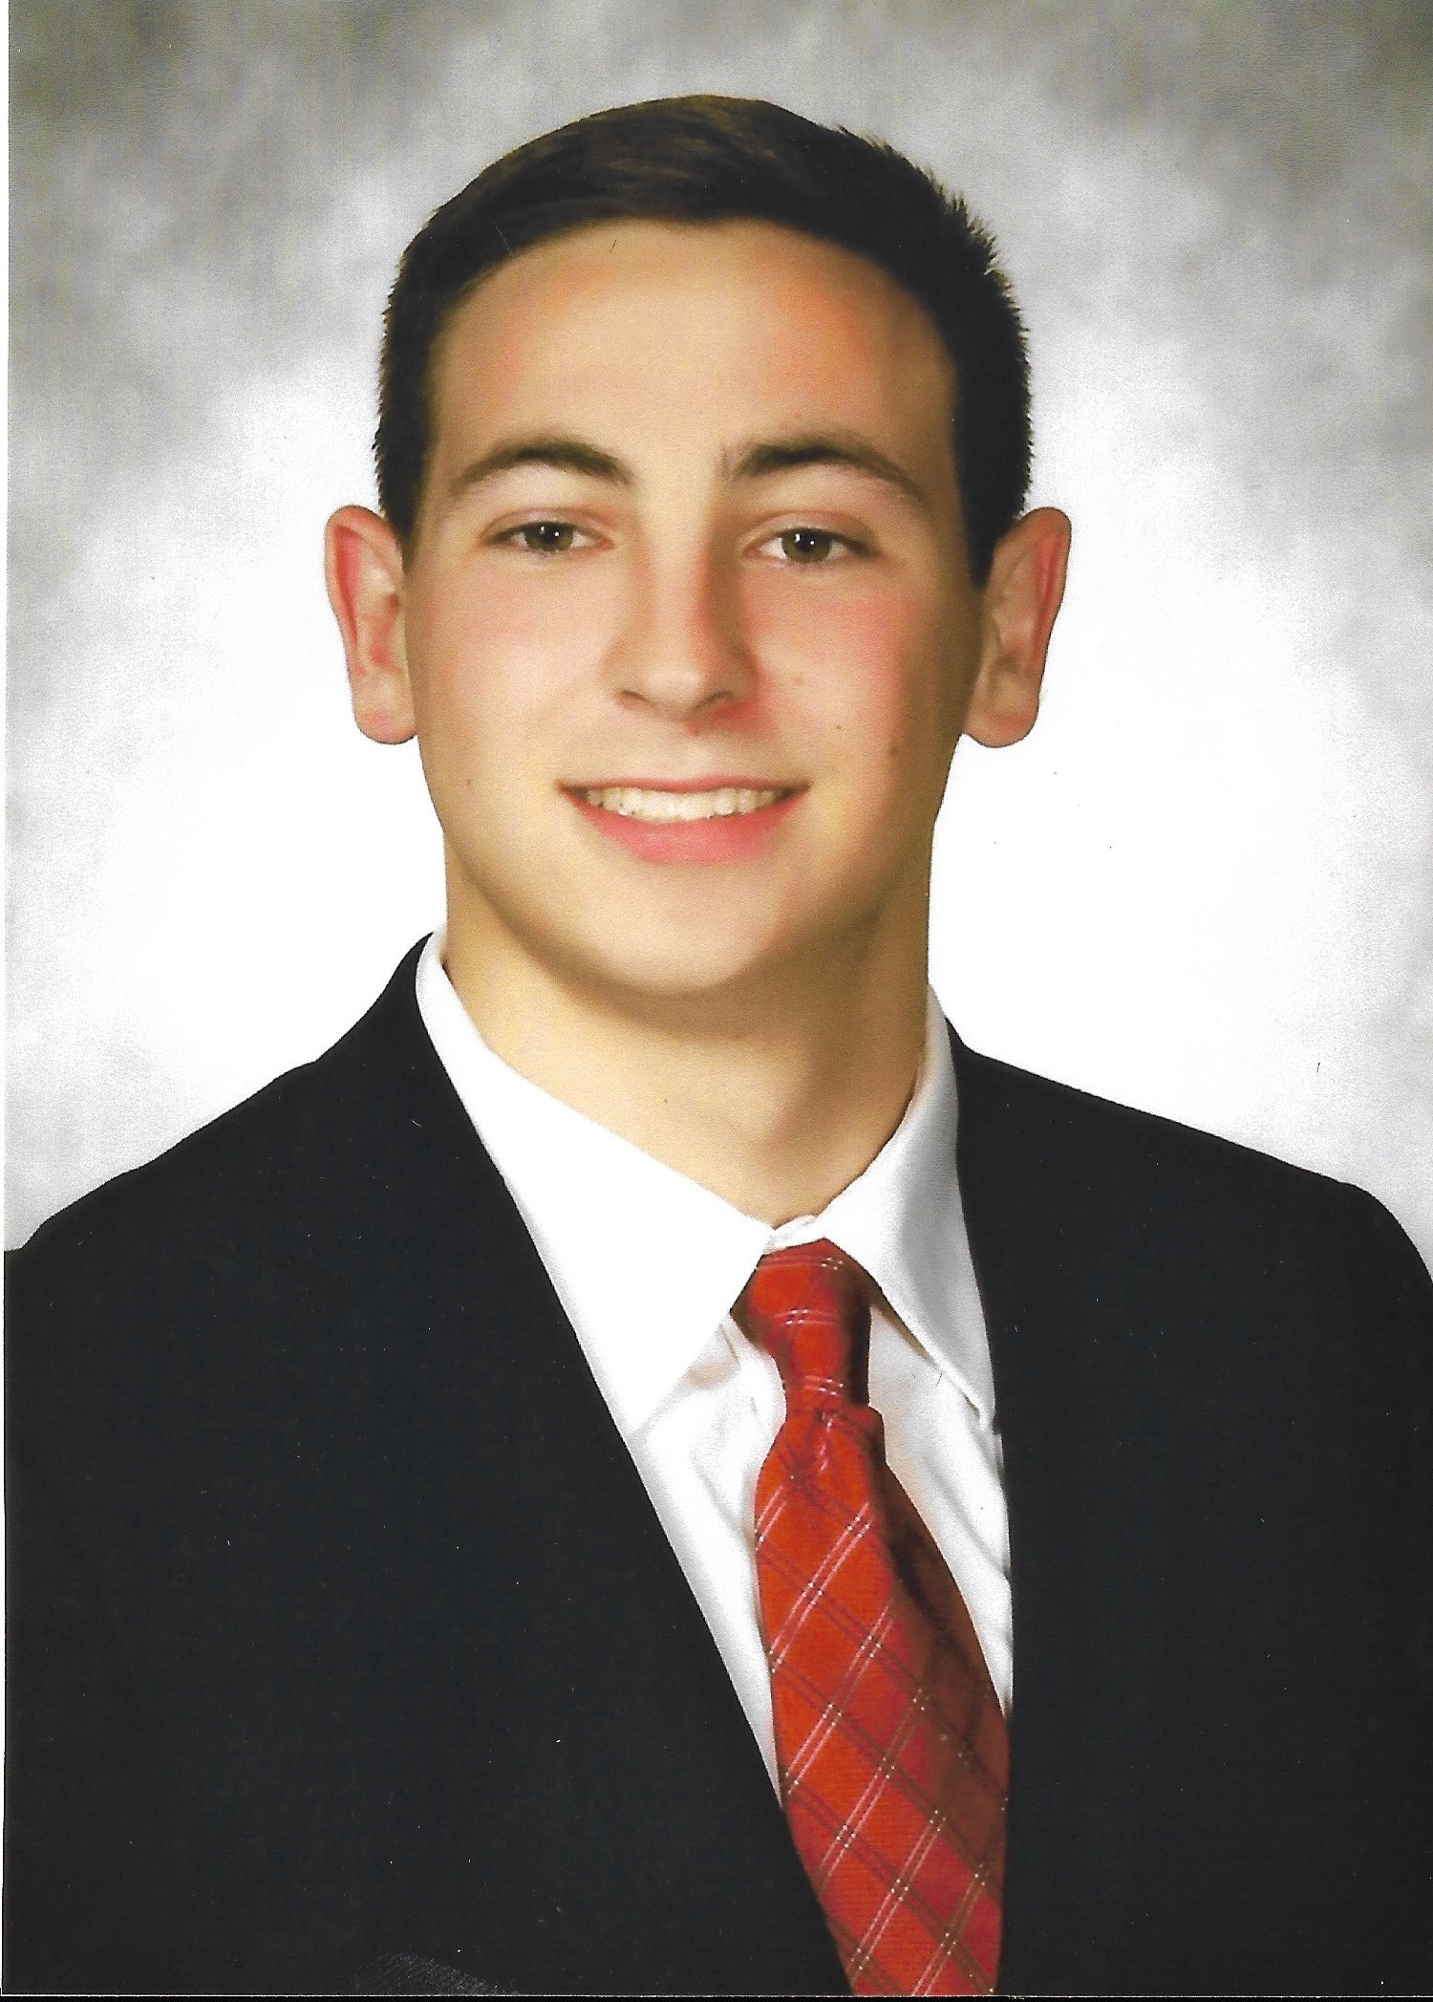
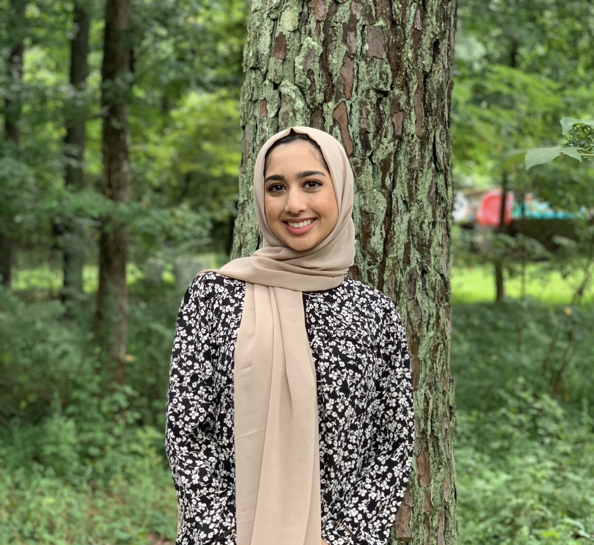
Meet the Team
Connor Koscevic Conflict Manager & Financial Advisor
Lane Corum
Risk Analyst
Hale Otto Spokesperson
May Hu Project Manager
Daniel Saul Web Developer
Sharmeen Zaman
Client Outreach & Relations
‹#›
Notes:
Speaker: Connor → May → Lane → Daniel → Hale → Sharmeen
Connor: I am a third-year MIS & Management student & I was the conflict manager and financial advisor for this project.
Daniel: I am a third-year MIS student, and I’m the web developer for this project. I was in charge of creating the website for Donut Worry
Lane: Good Morning. My name is Lane Corum and as the risk manager, I was in charge of documenting and continuously controlling risks associated with this project.
Hale: Good morning, my name is Hale Otto and I am the Spokesperson for Donut Worry.
Sharmeen: My name is Sharmeen and I am in charge of client outreach and relations

Slide 3
Table of Contents
Meet the Team
Executive Summary
Stakeholder Analysis
Project Scope
WBS
Risk Analysis
Timeline
Budget
Website
Summary
Lessons Learned
Questions
Notes:
Speaker: Sharmeen
Now that we have met the team, we will move on to the executive summary followed by the project scope, We will then provide a demo of the website and explain the WBS. We will go through the processes, then the risk matrix and the budget. We will conclude with the teams lessons learned and a summary. We will then that any questions you may have at the end
Let's start off with Daniel who will tell us about the executive summary of the project

Slide 4
Executive Summary - Client Overview
Background
Opportunity
Local business in Lawrenceville, GA.
Established in 2014
Develop a website to showcase the products and services offered to expand business
Desired Impact
Goals
Provide the shop with a proper website they can use themselves as a starting point to propel further advertising
Intend to market the shop to attract customers and give them a credible and clean source for ordering
Notes:
Speaker: Daniel Saul
The client for our project is a donut shop called Donut Worry based in Lawrenceville, GA. They were founded in 2014 and are a family-owned business. Being in a slightly remote area of Lawrenceville, physical advertising the shop is quite hard. As an opportunity arose, we decided to help the restaurant out and build a website for them to display their donuts and products, along with providing store information and promoting online ordering. This being the overarching goal. The impact the website will have is to attract customers and serve as a more efficient way to reach customers instead of their current Facebook business operations.

Slide 5
Executive Summary - Creating Value
Tangible Value
Online Ordering
Catering Inquiry and ordering
Intangible Value
Establishing online presence
Improving business credibility
eMail Marketing
Paperless Menu
Notes:
Speaker: Lane
A website can add both intangible and tangible organizational value to a business.
Tangible Value:
Online Ordering: our website points users to GrubHub, donut worry’s third party online ordering service
Catering Ordering: allowing users to order larger orders by the click of a button frees up workers to complete the orders
Intangible Value:
Establishing online presence/Improving business credibility: these two go hand in hand.
eMail Marketing: like most websites, ours has the capability of capturing emails to be used for email marketing, which is a great way to remind customers of seasonal items and promote discounts
Paperless Menu: As we all know, COVID has presented different ways of conducting business, especially in the restaurant industry. Paperless menu alow for customers to enjoy the full experience of donut worry
Passing off to: Hale

Slide 6


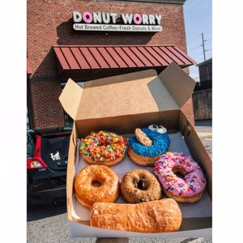
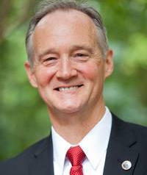
Stakeholder Analysis
Project Team
Customers
Donut Worry Clients
Project Executive
Dr. Huber
Project Sponsor
Sophal China
Notes:
Speaker: Hale
Transition: Thanks Lane!
Project Team: Delivering an efficient and effective website for Donut Worry Coffee and Donut shop so that they can utilize a tool to generate more income, give easy access to the clients that they serve, and have a way to showcase their business to customers nearby.
Project Sponsor: Their overarching goal is to drive profits by making more sales through expanding the reach of the store – an online presence that illustrates their menu options and store information will constitute as a “win.” Sophal China will provide background information on the current state of the company, the current customers, and their short-term and long-term goals.
Customers: They will use the website to make online orders and see what is offered and in stock to purchase at that specific moment in time.
Project Lead: Dr. Huber is overseeing the project and is the source behind what we deliver to our client. The Donut Worry shop knows that he teaches this class and is the reason behind this project.
Now, going to hand it off to Sharmeen to discuss the scope related to this project.

Slide 7
Scope
Task Description | Who is responsible? | Due Date
Meet with sponsor to discuss expectations of project | Web Developer | Early February 2021
Gather information about project and divide tasks | All Team Members | Late February 2021
Create website for Donut Worry | Web Developer | Early March 2021
Check with sponsor to ensure the project is desirable | Client Outreach | Mid-April 2021
Notes:
Speaker: Sharmeen
Thank you Hale, I will be talking about out major scope actitvites
The project is made up of four main tasks.
The first task is to meet with the sponsor to discuss what they want achieved for their business. This is a very important step because it sets the foundation for the entire project. We will refer back to the ideas brought up in this meeting for the remainder of the project.
The second task is gather and organize all the information presented to us and divide them among the group members. This is the responsibility of the entire group. We will be able to work together as needed but this is where we assign specific tasks to each member.
The third task is creating the actual website for donut worry. This is when we take all the information from the first task and all the research from the second task to complete the actual website. This is the part of the project which will create value to the business. We will periodically check in when needed but the completion of this task will bring us to the final major task.
The fourth task is checking in with the sponsor to ensure all the desired goals were met. This is when we would make adjustments to the website as needed and ultimately complete our project. The client outreach would be responsible for this final task and will make sure that the project achieved the goal of creating value to Donut Worry
Now ill be going into more detail in the work breakdown structure

Slide 8
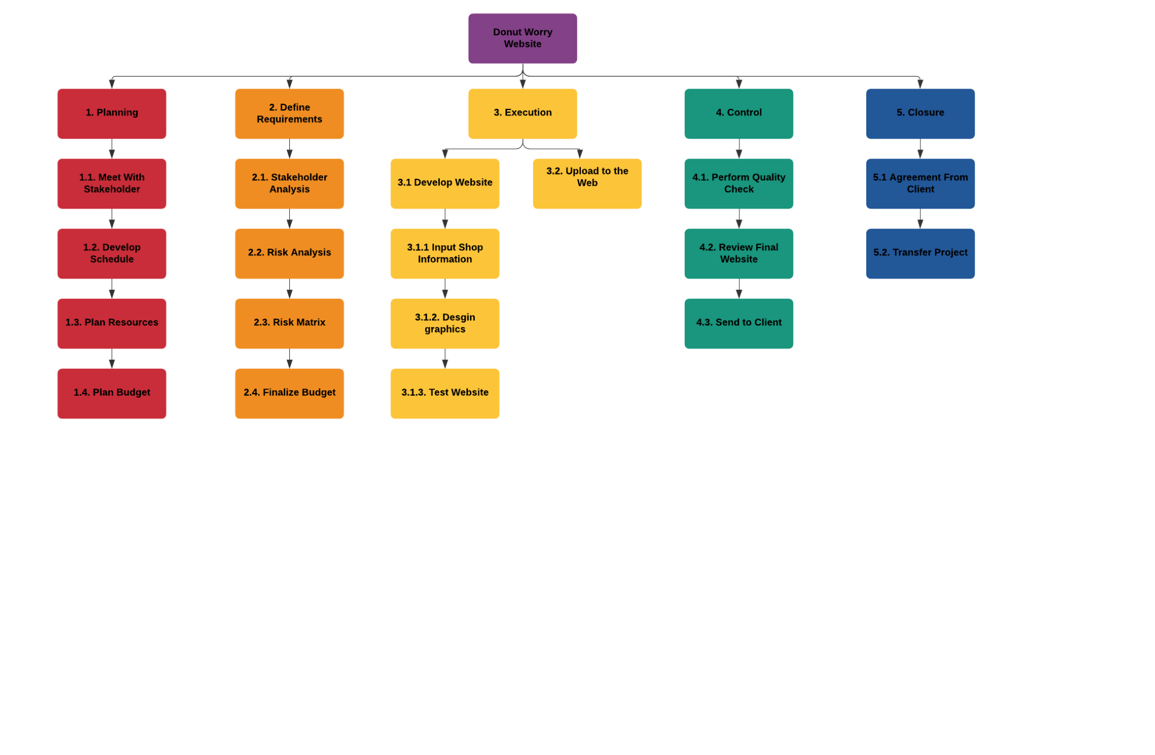
WBS: Graphical Layout
Notes:
Speaker: WBS
This WBS we see here is a graphical layout, however, there will be an outline layout in the appendix.
The WBS allows us to see the relationship between all the major project deliverables starting off with the planning phase. This phase is the beginning of the project where we meet with the stakeholder, develop the schedule, and plan resources and budget.
The second phase of the project is defining requirements, this phase sets the tone for the entire project and is where we organize all our information. By developing the Stakeholder analysis, risk analysis, risk matrix, and finalizing the budget, we are able to stay organized and on track for the remainder of the project.
The next phase is execution. This is where we develop the website for Donut Worry and work with the stakeholder to create value for their business. This is the part of the project that allows us to get creative and design a website perfectly catered to this local business.
The fourth phase is control. This phase involves performing quality checks, reviewing the final website and sending it to the client. This is part where we can alter the website as needed and really make sure we created something the stakeholders will find beneficial.
The final phase in the project is Closure. This involves agreement from the client and finally transferring over the project. After this phase, Donut Worry is able to build off our foundation and maintain the website.

Slide 9
Risk
Description | Score | Comments
COVID-19 break out within project team | 4 | Project team is leveraging remote telecommuting technology to minimize COVID-19 exposure
Web development platform crashed | 11 | Because wix is such a robust site, it is unlikely that it will crash. If it were to crash or be unavailable it would put our project to a stop
Sponsor decides project is not feasible | 5 | Project team will remain highly flexible with project sponsor in regards to scope, planning, resources, budget, and schedule
Scope of project increases | 9 | Slight increases of the scope may happen depends on project sponsors needs, major scope increases will need to be addressed by the budget and schedule of the project
Notes:
Speaker: Lane
Thanks Sharmeem!
Risk is something that every project faces, and during the COVID-19 pandemic, we were faced with unparalleled risks.
Here we have four relevant risks, their risk score, which was calculated by multiplying the likelihood and the impact, and additional notations regarding the risk.
At the forefront of our risk analysis was a COVID outbreak within our project team. We decided to leverage telecommuting technology to minimize exposure to one another.
Another risk that we defined was the reliability of the WIX development platform. Although WIX is a robust platform, a crash would put our project to a standstill. Luckily, we never encountered technical problems with the platform.
Shifting our focus to the project sponsor, Ms. China, it was possible that she would decide that a website is not feasible for her business or that it is something that she would not like to persue right now. To combat this, we ensured that we would remain flexible with the project sponsor.
We also had to manager unrealistic expectations from the project sponsor. Slight changes in scope are when first working with a client, but major scope changes will need to be addressed by the budget and schedule of the project.
Hand off to: May

Slide 10
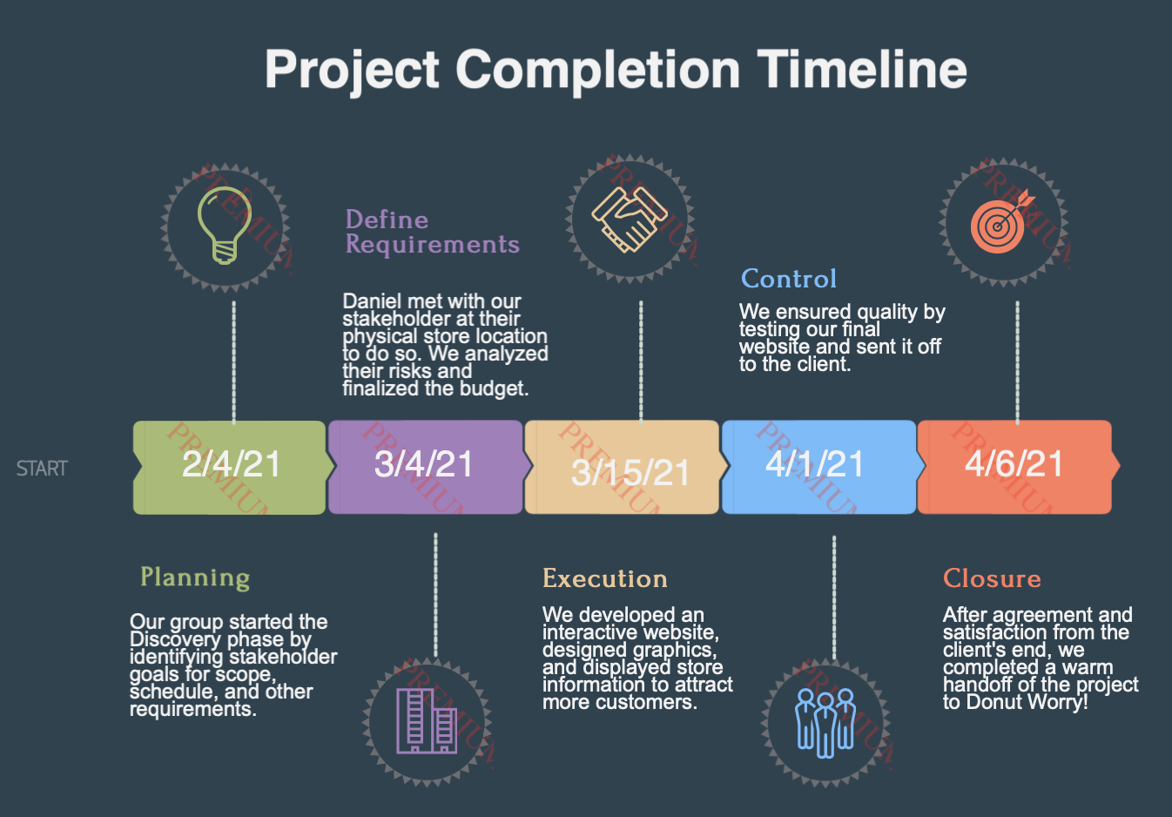
Notes:
Speaker: May
I AM GOING TO PASS THIS OFF TO CONNOR TO TALK ABOUT THE BUDGET

Slide 11
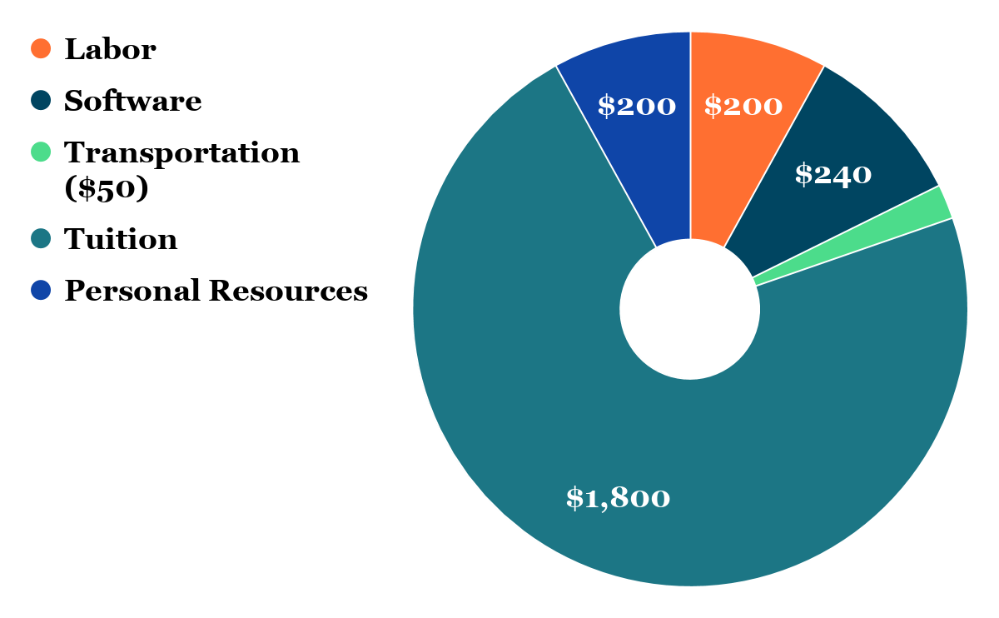
Budget
Notes:
Speaker: Connor
Thank you May! Sorry for my tardiness, my wifi and power cut out right before class started, but I’ll quickly introduce myself and then tell you about our budget! I’m Connor Koscevic, a third-year MIS and Management student. I was the conflict manager and financial advisor for this group. Moving on to our budget, I’ll start with the most expensive component and work my way around the donut chart. As you can see there, our tuition charges add up to $1800 with this class costing about $360 & 5 students taking it. Next, the personal resources required for this project came out to $200 total, which was calculated based on our power, wifi, and personal computer costs for all 5 of us. Then our labor costs were calculated based on the assumption that website interns make $20/hour and it took Daniel about 10 hours to create the website. Additionally, in regards to the software expenses, Wix charges $20 per month for their premium subscription, so the yearly software cost will equal $240. Finally, Daniel actually went to Donut Worry about a month ago to meet with the client & take pictures for the website. It was about a 75 mile round trip for Daniel & he spent money on donuts and coffee while there. This combined with the cost of gas to get to and from the store totaled $50. Altogether, our project budget equaled $2,490.
Now I’m going to toss it to Daniel to give you a demo of the website.
Budget
Tuition- 3 credit hours. $ 360 per class * 5 students = $ 1800
Labor- website interns get $20 an hour so $20 * 10 hours = $200
Software- $20 a month. $20 * 12 months = $240
Transportation- make up number
Personal resources - make up number

Slide 12
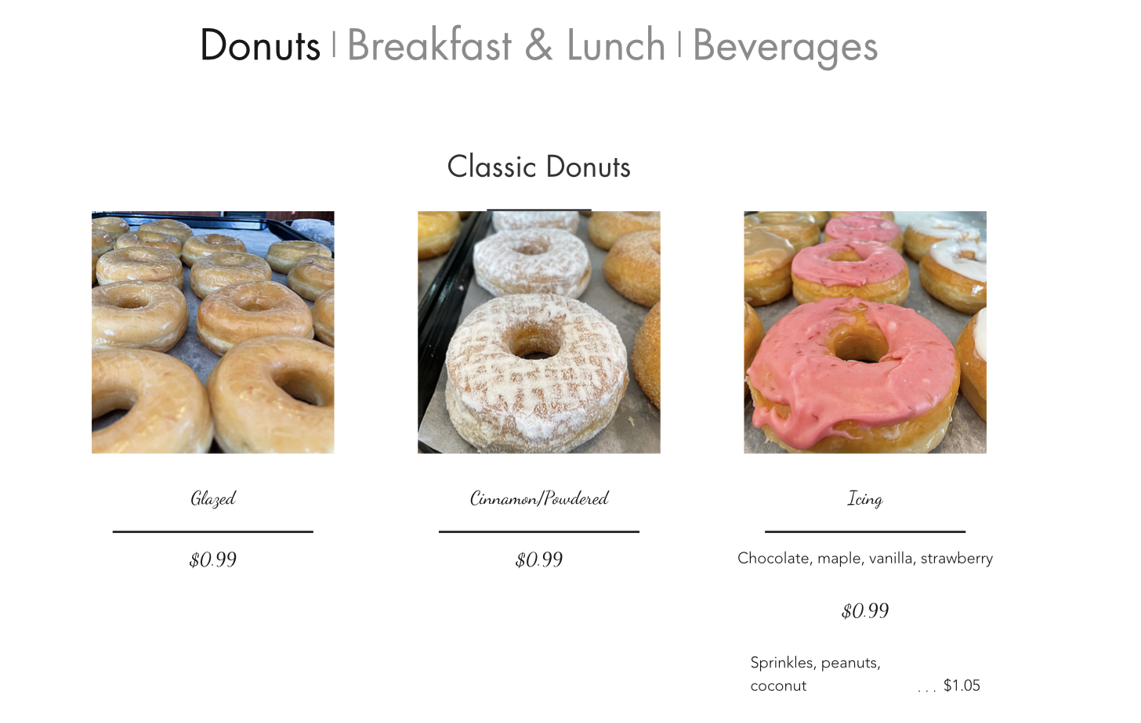
Website
https://danielsaul.wixsite.com/donutworry
Notes:
Speaker: Daniel
Here is the link to the final website I created for Donut Worry. It was built with the Wix software, currently holding my Wix account name as a domain name. I will be giving a short tour of the pages. The home page displays a navigation bar with a hyperlinked buttoned that takes you to the online ordering interface. In addition to the online ordering button, the website comes equipped with a home, about, menu, contact, and FAQ page. There are also buttons linked to the store location, Facebook, and Instagram pages of the shop. The home page gives a description of the store hours and drive-thru, photos of the store and donuts, and a short description of the store. The about page displays the awards, news, and a paragraph of the founding of the donut shop. The menu page shows the different products such as donuts and coffee, as well as their prices and add-ons. The contact page has a typical contact form along with the store phone number and email. The FAQ page includes frequently asked questions that a customer may ask or want to know before ordering donuts at Donut Worry.

Slide 13
Summary
What Went Well
What Went Wrong
Every member followed through with tasks properly and had a cooperative attitude.
Finding time to meet up and partition tasks with our busy schedules.
How to Improve
Takeaways
Develop better communication with the sponsor and understand their expectations.
Frequent communication with the sponsor and understanding their expectations is crucial to the success of the project.
Notes:
Speaker: May
THANKS DANIEL!
I AM GOING TO NOW TRANSITION INTO OUR LESSONS LEARNED, where all members will share their piece of wisdom

Slide 14
Lessons Learned
Being honest with what we can and cannot deliver is the cornerstone of any successful project.
Document all possible risks, even if there is a very slim chance that they will happen.
Knowing all of the information needs of every project member is important for this project to execute efficiently and effectively.
May Hu Project Manager
Lane Corum Risk Analyst
Hale Otto Spokesperson
Creating a project budget requires specific attention to detail and helps map out all of the resources used in a project.
Project sponsors don’t always communicate on time and effectively.
For team members to all be aligned, we must be open and transparent.
Connor Koscevic Conflict Manager
Daniel Saul Web Developer
Sharmeen Zaman
Client Outreach & Relations
Notes:
Speaker: May → Lane → Hale → Connor → Daniel → Sharmeen
Lane:When we started the risk discovery phase, we were not coming up with many risks, as we thought this project would go smoothly. There were many risk that we were thinking of and not documenting because we thought there was such a slim chance that we would have to combat them. In the future we now know to document ALL risks so that you have a plan on how to manage them.
Daniel: The lesson I learned from completing this project is that project sponsors don’t always communicate on time and when you need them to. During our gathering requirements phase, I visited the store to collect information and pictures for the website. I met with the store manager, our project sponsor, and she gave me plentiful amounts of ideas and things they wanted on the website. However, when I followed up with the manager via email, she did not respond very often to questions regarding the website. This made it quite difficult to completely understand what the donut shop wanted to show their customers online.
Sharmeen: An important lesson I learned is that communicating and setting deadlines is important for the success of the project. Because there are so many group members involved, it is harder to plan to meet up at a convenient time for everyone. Therefore, it is important that everyone is on the same page and knows what is going on with the project at all times.
Hale: The biggest lesson that i learned is that you need to know each team member’s role and responsibility and be able to cater to everyone’s needs. All of the deliverables in this project are intertwined and it is important to communicate and provide information to each team member so that the project executes effectively and efficiently.

Slide 15
THANK YOU!
Any questions?
Notes:
Speaker: Sharmeen
Thank you so much for listening to our presentation, if any one has questions, i would love to take them now.

